Slide 1
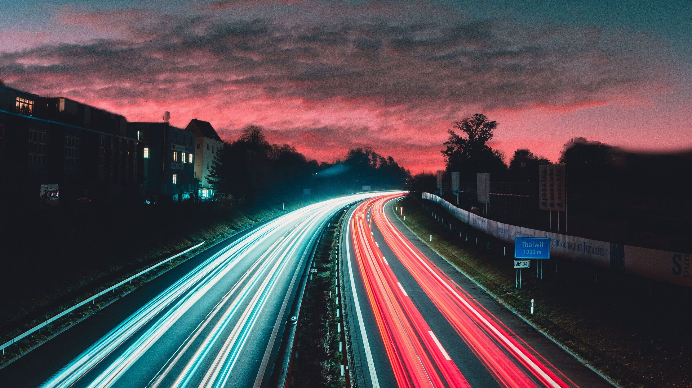
P13: Highway traffic monitoring
Ivan Jurić, Angel Spasov, Kristina Host
Summer School on Image Processing
Rijeka, July 2021

Slide 2
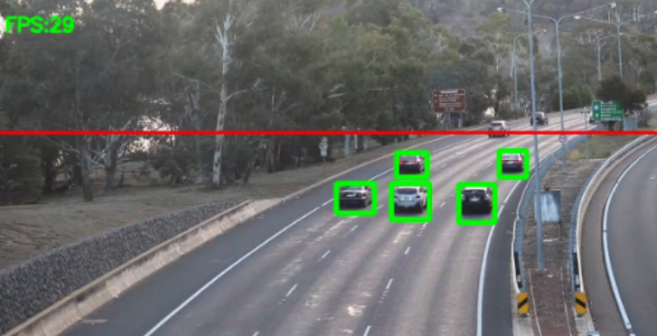
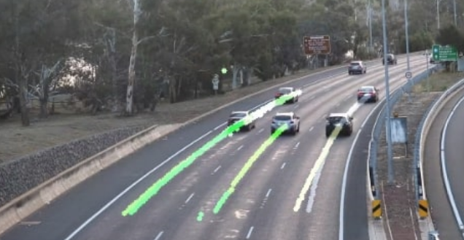
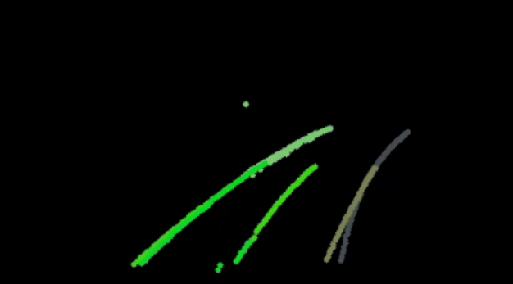
Problem description
The problem: Analyze video surveillance of the highways. The vehicles should be separated and tracked while they are visible. The team should consider the shadows, the different time of day as well as the different weather conditions. The team should also implement tracking abnormal vehicle movements, giving the possibility to detect accidents.
Dataset: Input can be found on YouTube searching “highway traffic surveillance videos”.

Slide 3
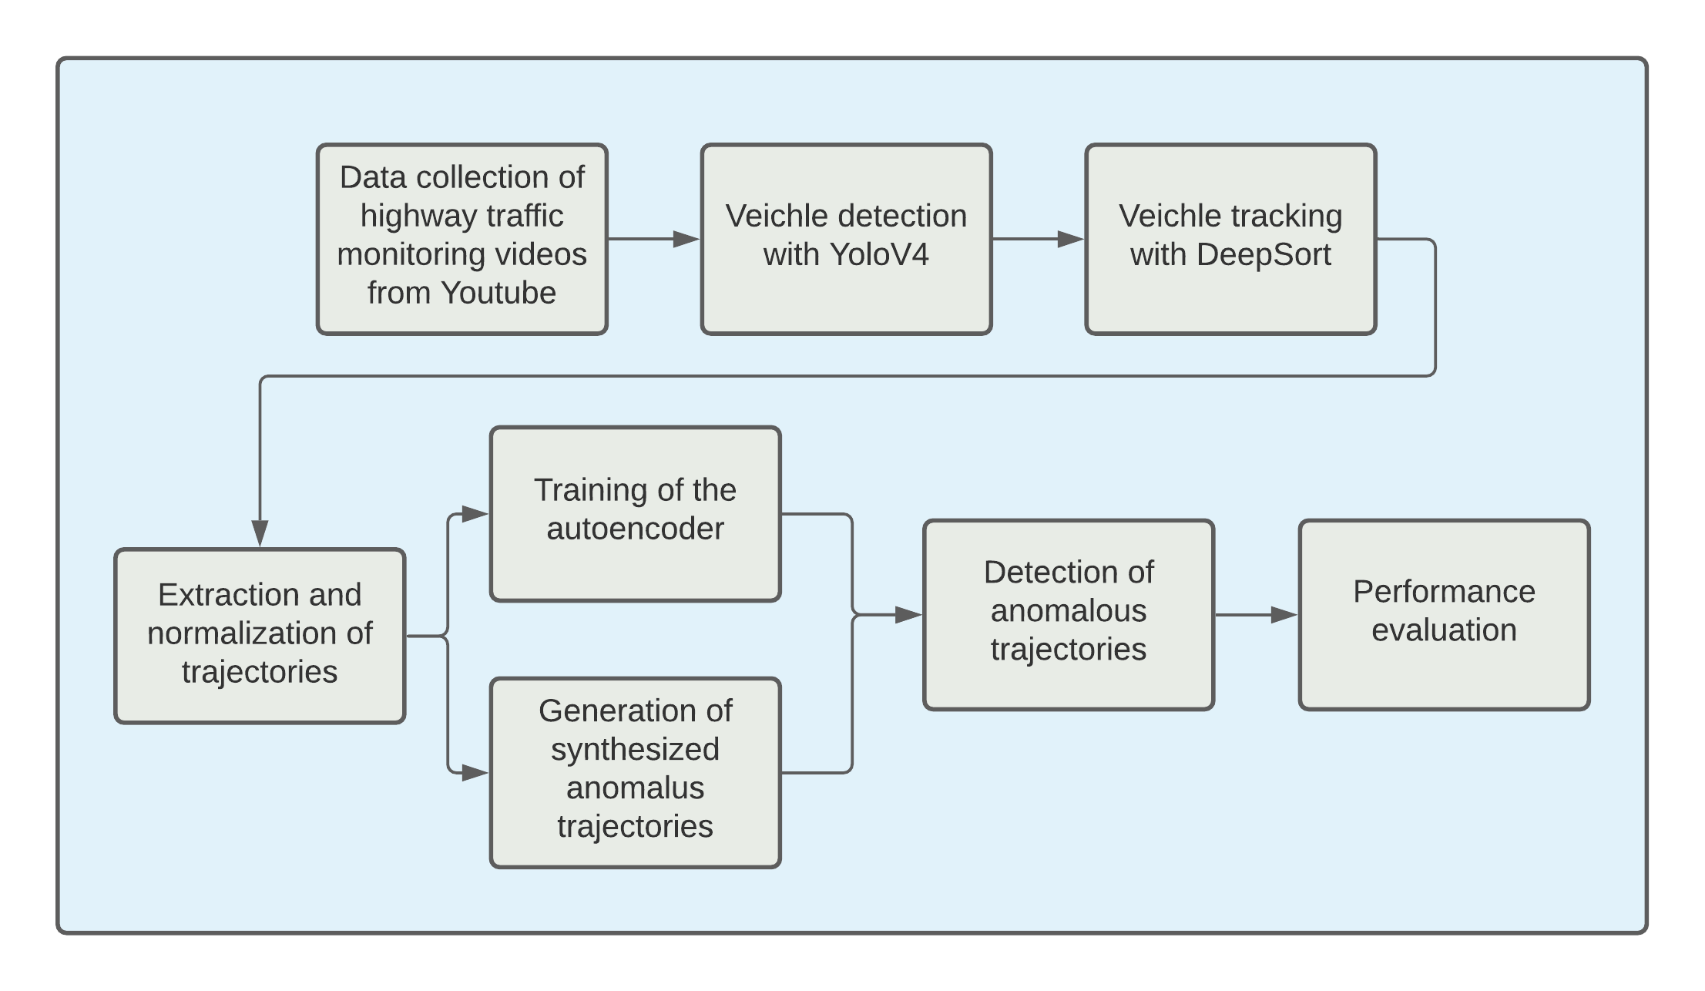
The workflow

Slide 4
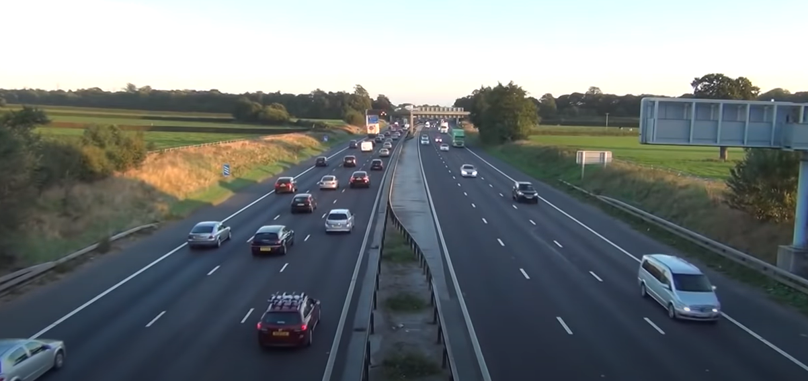
Data collection
There is no annotated data for our task
We collected videos from YouTube of highway traffic monitoring
Cars, trucks, and motorcycles
Our dataset: 34 min

Slide 5
Vehicle detection and tracking
Multiple vehicles moving at the same time
algorithm for multiple object tracking (MOT)
Tracking-by-detection
Vehicle detection: YOLOv4
can detect in real time multiple objects in a single frame
we used the obtained detection to steer the tracking process
the tracker may use the information it can obtain from the detected bounding boxes, e.g. the locations of box centroid, their dimensions, the relative position from the boxes in previous frames, or some visual features extracted from the image
Vehicle tracking: DeepSORT
goal of the tracker itself is to associate the obtained bounding boxes in different frames together so that the boxes containing the same vehicle are assigned the same unique ID
it uses the information about appearance of the tracked objects and considers only information about the current and previous frames to make predictions about the current frame without the need to process the entire video at once
Notes:
In the collected videos, there are a lot of vehicles such as cars, trucks, and motorcycles that are moving at the same time and need to be tracked in order to obtain trajectories and later recognize anomalies in driving behavior

Slide 6
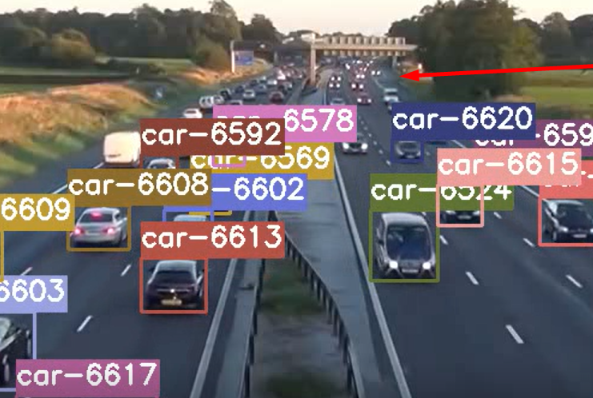
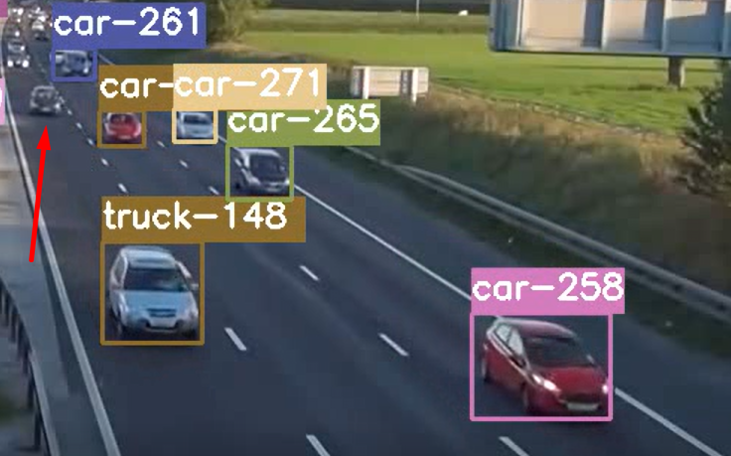
Challenges regarding detection and tracking
← Vehicles at significant distance from the camera
Missing detection →

Slide 7
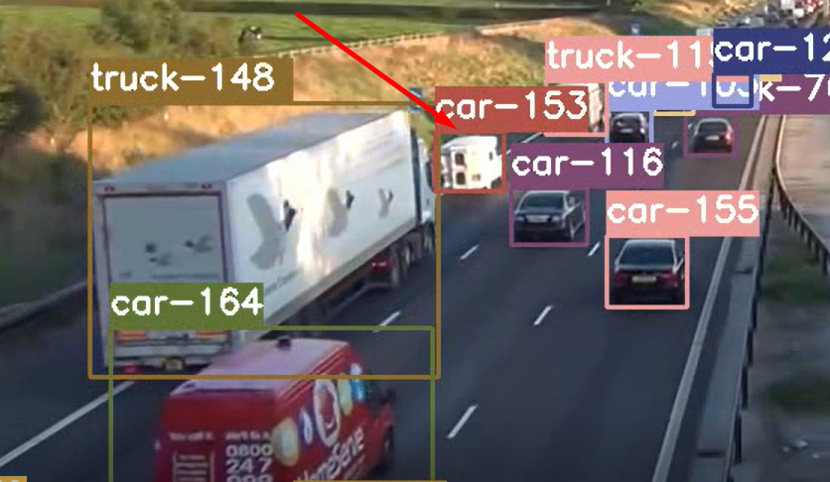
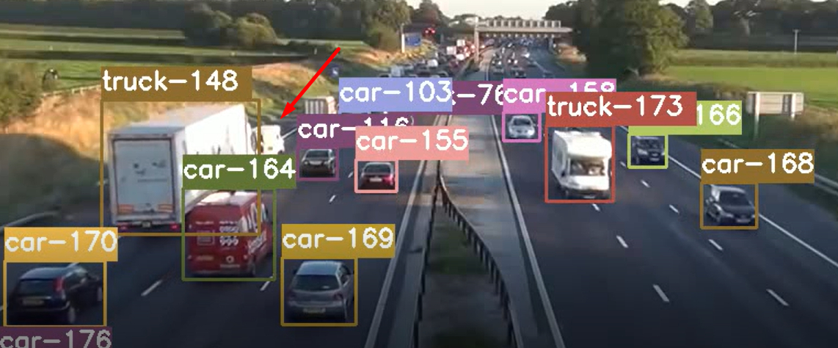
Challenges regarding detection and tracking
Occlusion
↓
The car-153 is occluded by the truck-148

Slide 8
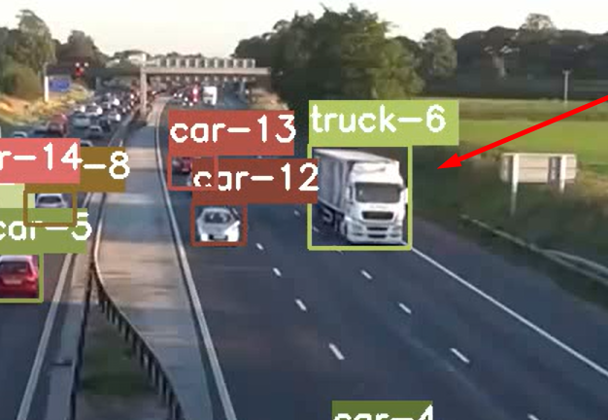
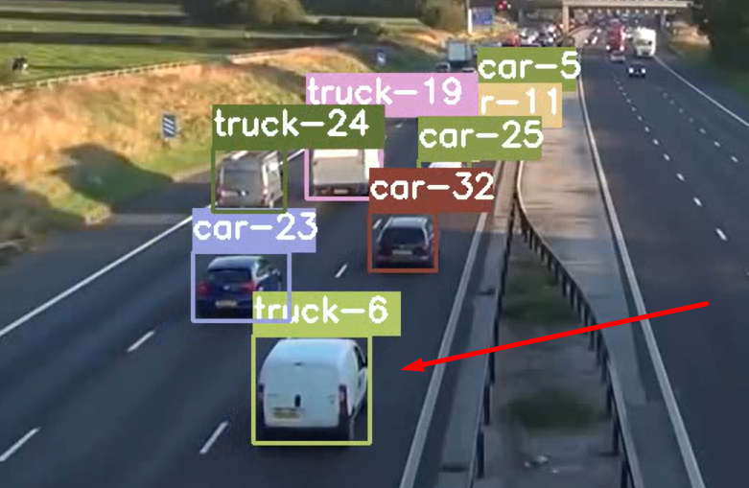
Challenges regarding detection and tracking
Re-identification problem
↓
The tracker remembered the appearence of the truck-6

Slide 9
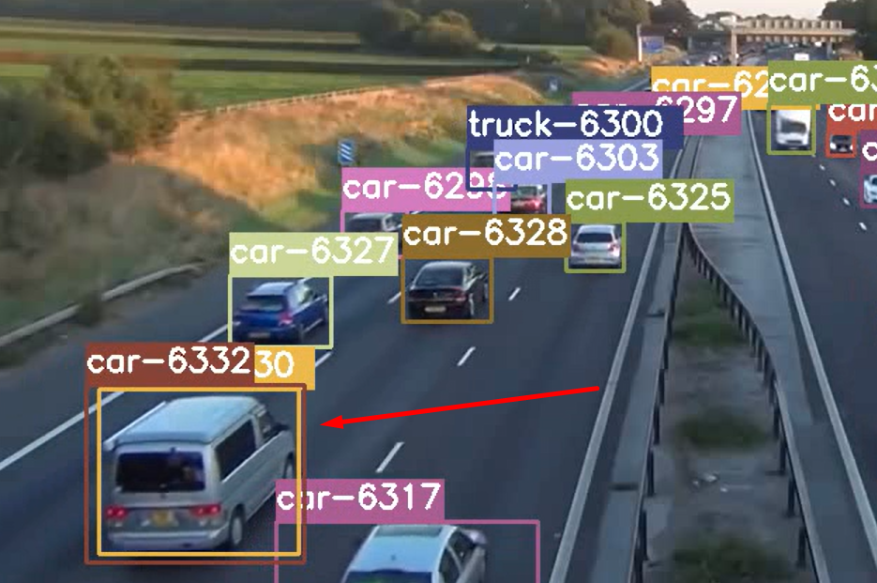
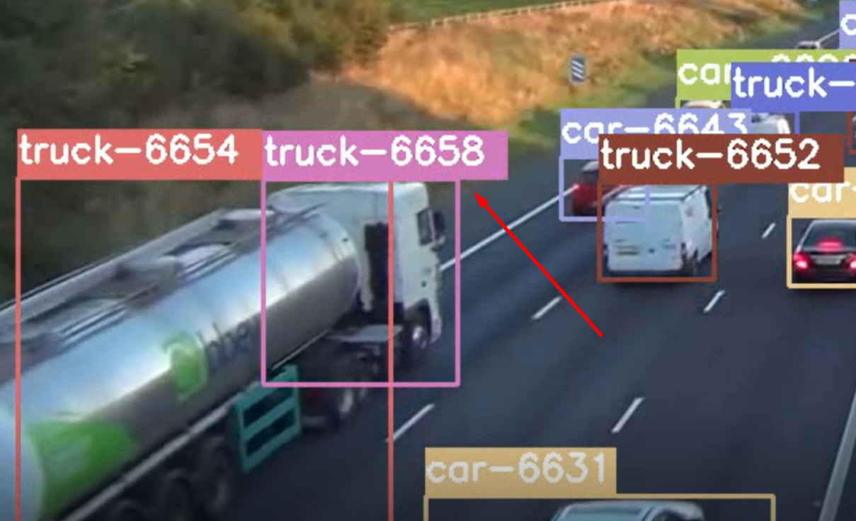
Challenges regarding detection and tracking
False positive
↓
↑
Multiple detections
there is just a part of the truck and not the entire one

Slide 10
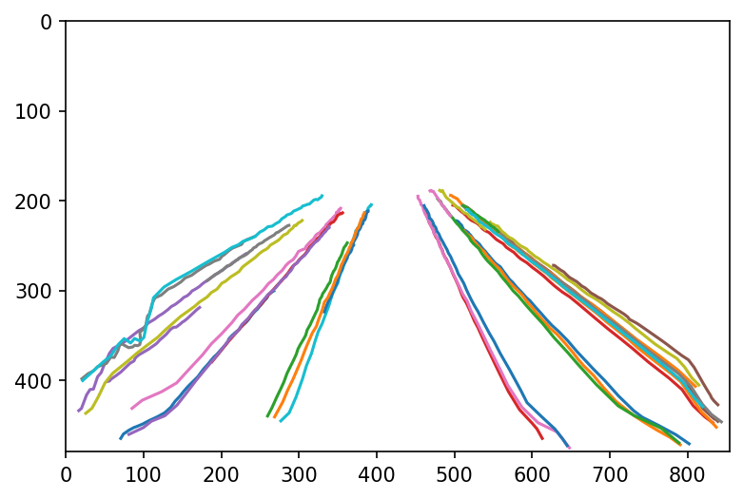
Trajectories preparation and normalization
The trajectories are arrays with x,y, t coordinates
We regularized them all to have the same number of timepoints, equally spaced out (numpy interpolation)
Multiple lanes going in different directions
Maybe we can standardize trajectories to make the encoder less dependent on scene geometry?

Slide 11
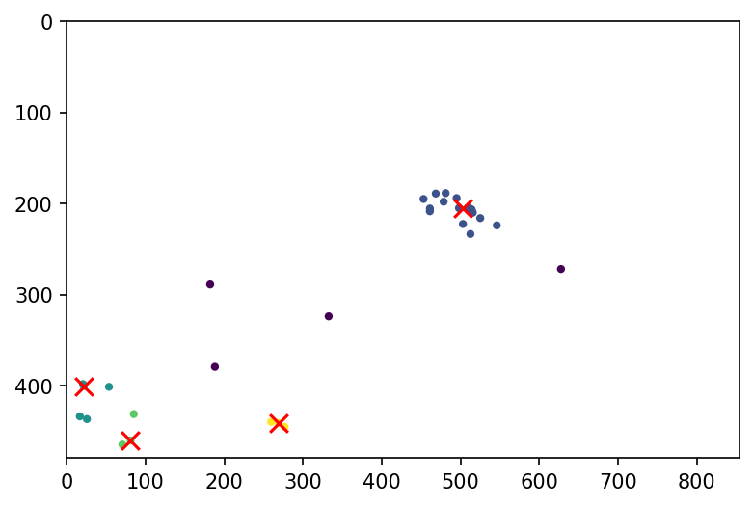
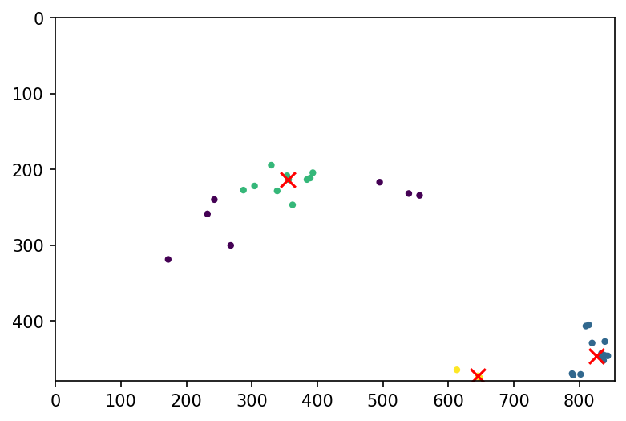
Trajectories preparation and normalization
Entry points
We plotted the starting and ending points of the trajectories, and run a clustering algorithm (OPTICS) to find typical entry/exit regions
Exit points
OPTICS
does not require the number of clusters prespecified
discards some points as outliers

Slide 12
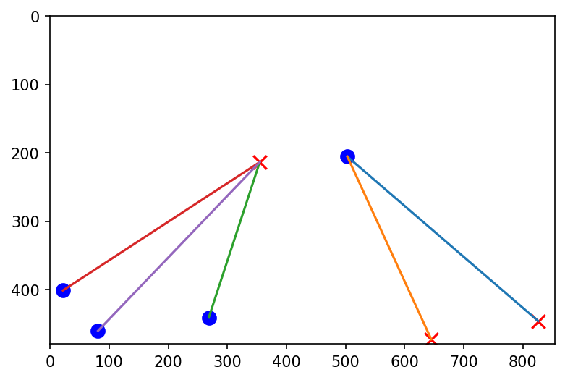
Trajectories preparation and normalization
We connected the corresponding entry and exit points to get the common connections
The count how many trajectories use each entry-exit pair

Slide 13
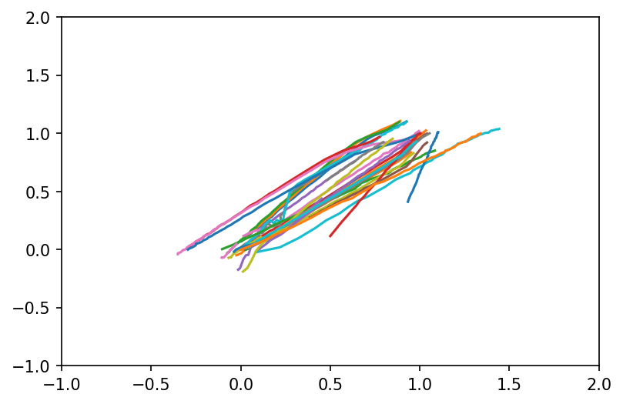
Trajectories preparation and normalization
We renormalized the coordinate arrays of each trajectory based on how similar they are to the closest matching connection
Minimal distance between starting/ending points of the trajectory and the cluster median
2
y
x

Slide 14
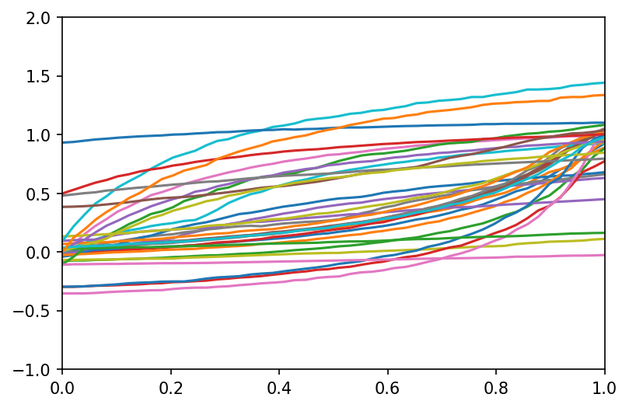
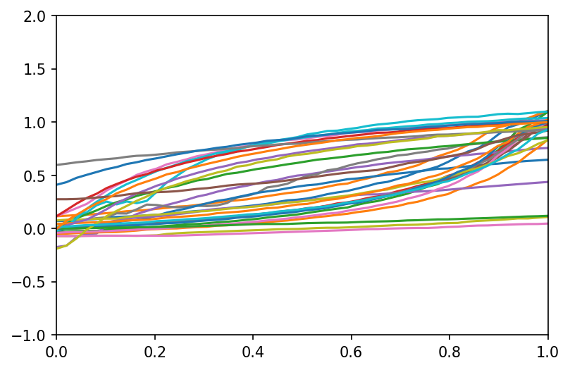
Trajectories preparation and normalization
2
We rescaled the coordinates so that the median entry point of the connection is (0, 0) and median exit point is (1, 1).
How would the actual trajectory coordinates change?
x
t
y
Maybe these renormalized trajectories would be more robust to geometry change?
t

Slide 15
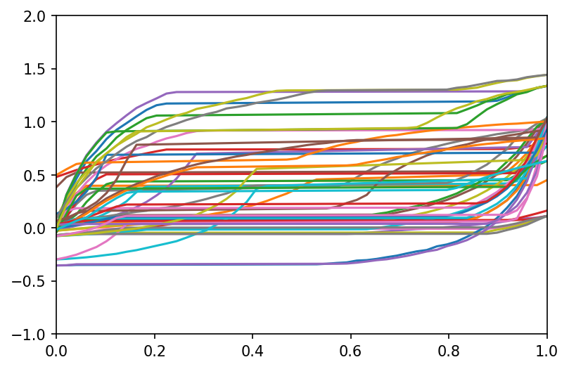
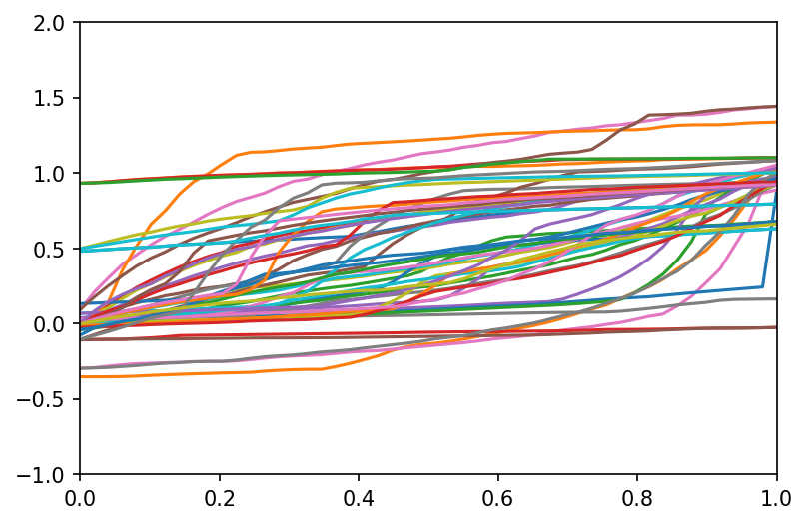
Synthesizing anomalies
The renormalized trajectories can be used to more easily generate anomalous trajectories based on real ‘normal’ ones
x
↑
The vehicles stop for a random amount of time in the middle of the road
t
The vehicles suddenly speed-up for a brief period of time
y
→
t

Slide 16
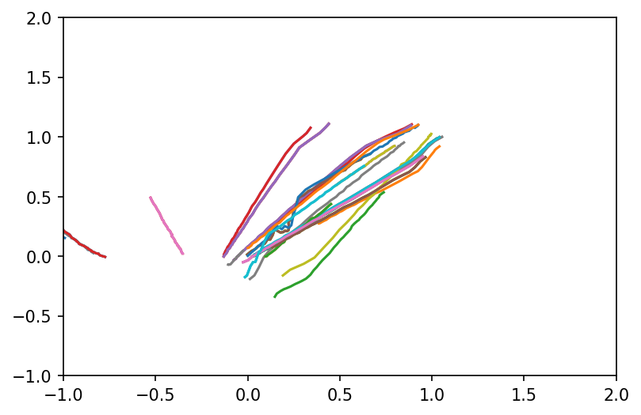
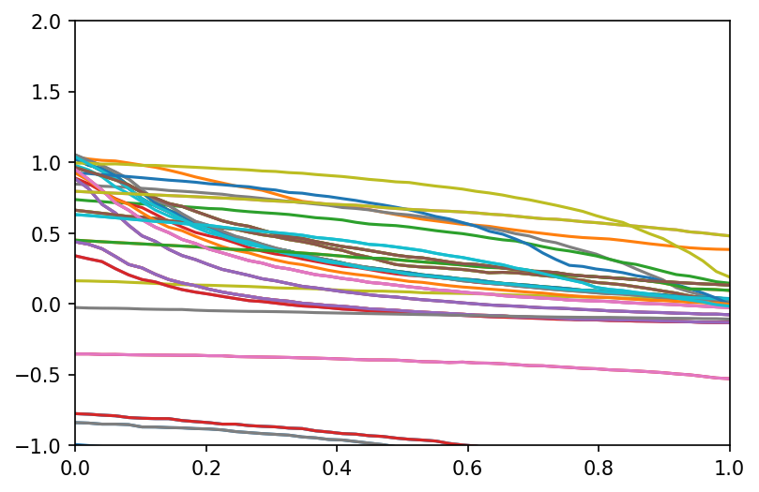
Synthesizing anomalies
The vehicles driving in reverse
have to reassign median entry/exit points afterwards
y
x
x
t

Slide 17
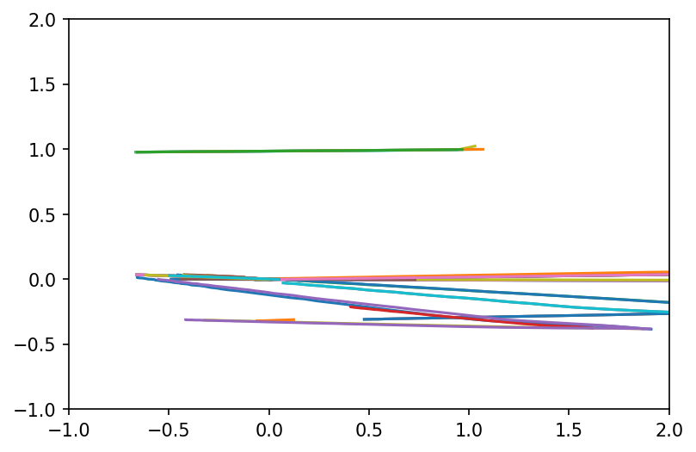
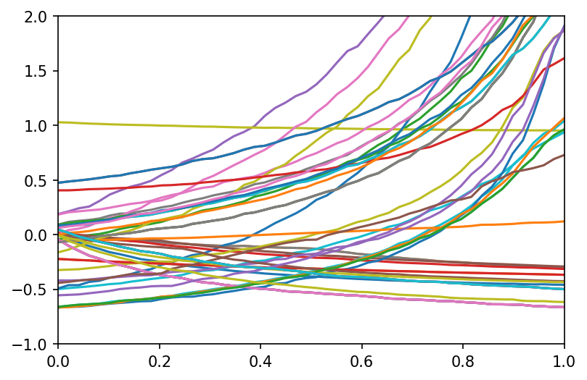
Synthesizing anomalies
The vehicles moving toward another median exit point (unstandard connection)
y
x
x
Other example: the vehicles starting from a different entry point
t

Slide 18
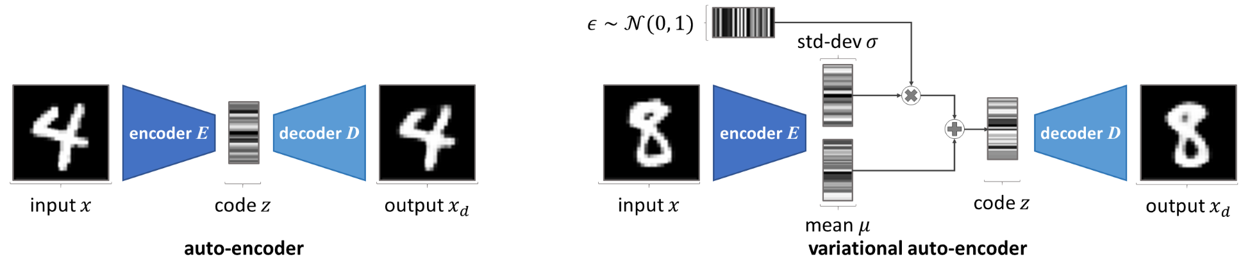
Variational Autoencoders
Autoencoder vs Variational Autoencoder
Goal is Image Reconstruction – discriminative
Unconstrained with discrete latent space
Learn distribution of the latent space
Goal is Image Generation – generative models
Constrained with continuous latent space
Learn distribution of the latent space

Slide 19
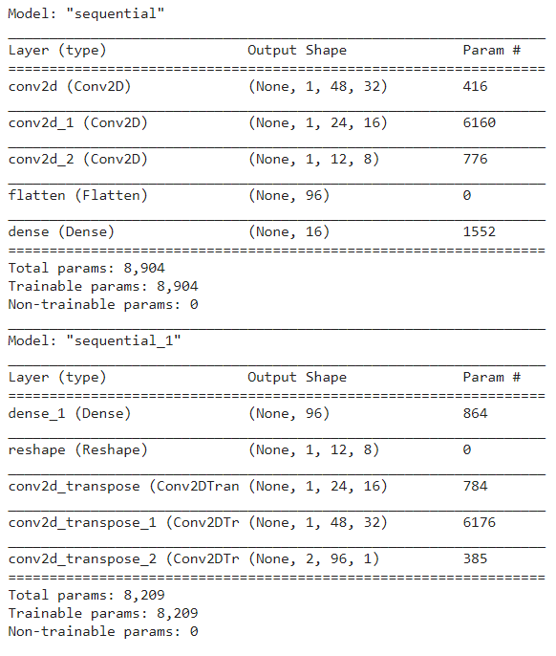
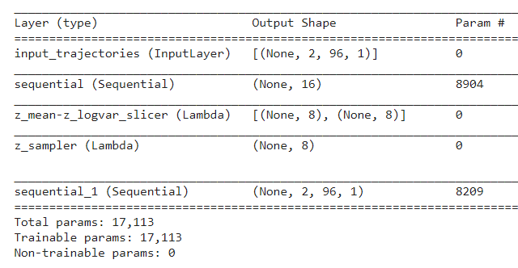
VAE architecture for the current problem
Encoder
Decoder
Combination
Mean
Variance
Sampler
LOSS:
MSE & KL Divergence

Slide 20
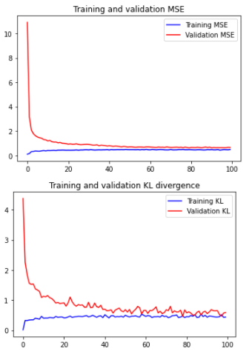
Training & Evaluation
Training Epochs: 100
Batch size: 32
Loss1: Mean Squared Error
Loss2: Kullback–Leibler divergence

Slide 21
We have RESULTS!!!???

Slide 22
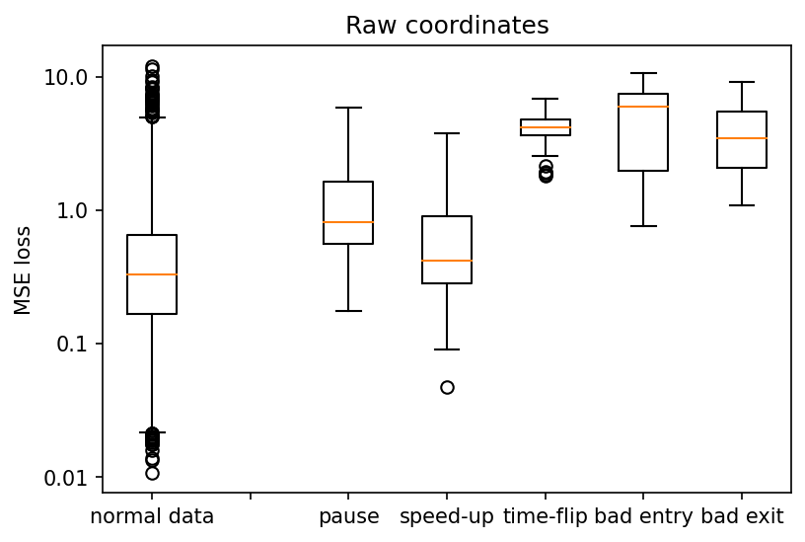
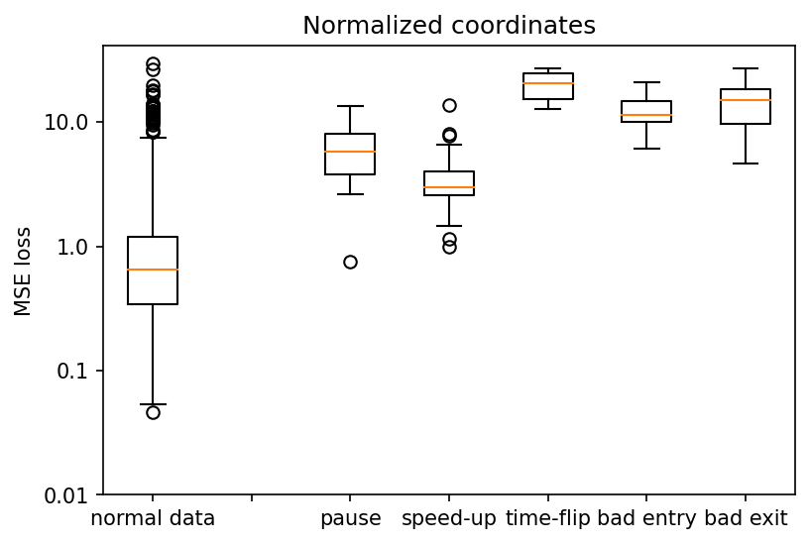
Results

Slide 23
Results

Slide 24
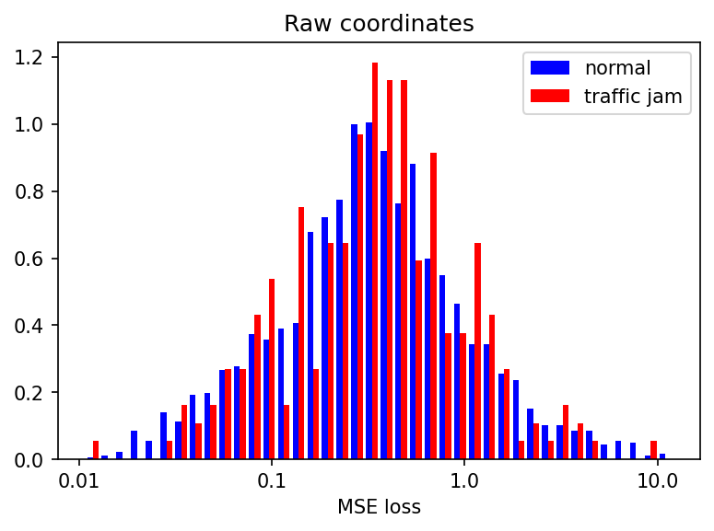
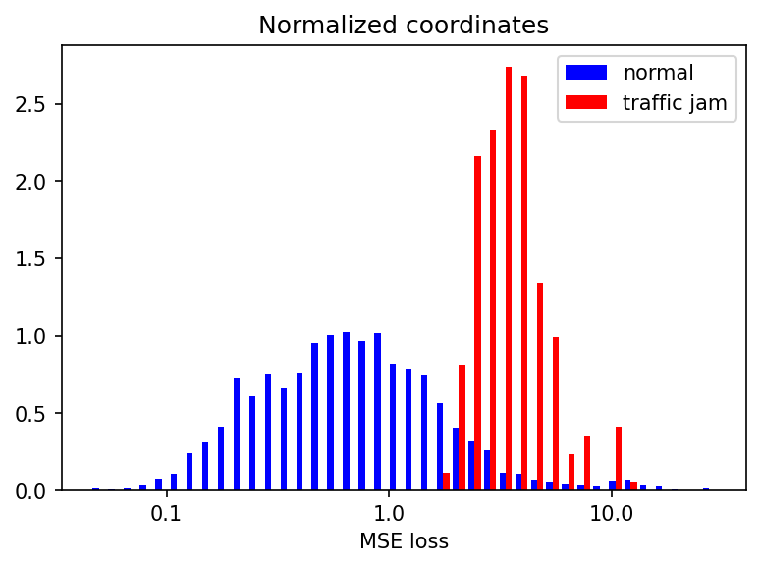
Results

Slide 25
Thanks for listening!
Any questions?
Angel Spasov: GATE Institute, Bulgarija, an.spasov@googlemail.com
Ivan Jurić: Visage Techologies, Croatia, i.juric.phy@gmail.com
Kristina Host: University of Rijeka, Croatia, kristinahost@gmail.com

